Slide 1

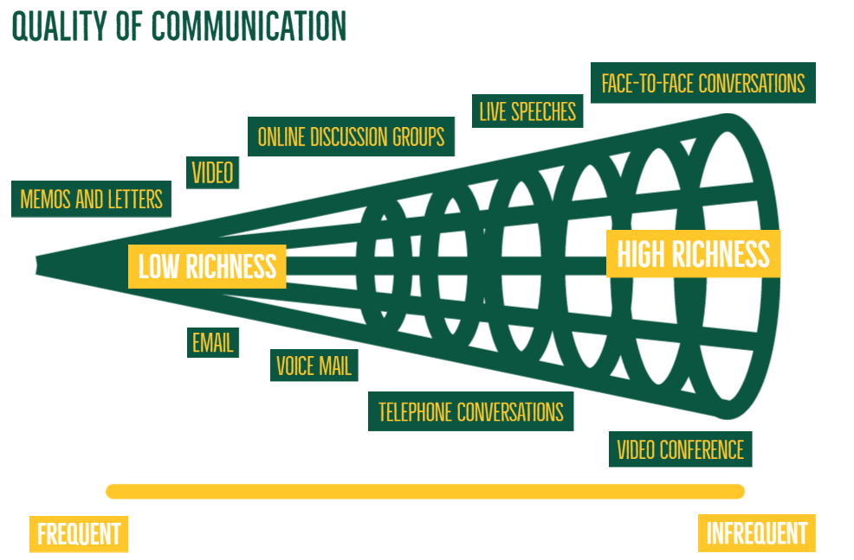
Communication
It is a process of creating and sharing ideas, information, views, facts, feelings from one place, person or group to another. Communication is the key to the Directing function of management.
A manager must communicate his directions effectively to the subordinates to get the work done from them properly

Slide 2
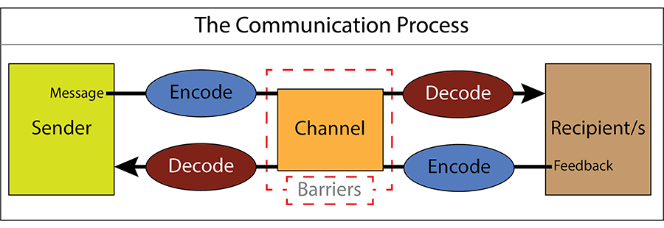
In management communication refers to the process of conveying and exchanging the information, ideas, concepts, thoughts and instructions with in an organizations. Such as product and its working plan and details, Management and customers expectations, employee’s working process and progress, product design and redesign, market and competitors etc. in order to creating clarity and understandable the situations, providing the directions and guidance, conflict resolution and motivation as well as decision making through the communication process of verbal, nonverbal, written and visualizing for achieving the organizational goal.
Communications is a continuous process that mainly involves three elements viz. sender, message, and receiver.

Slide 3
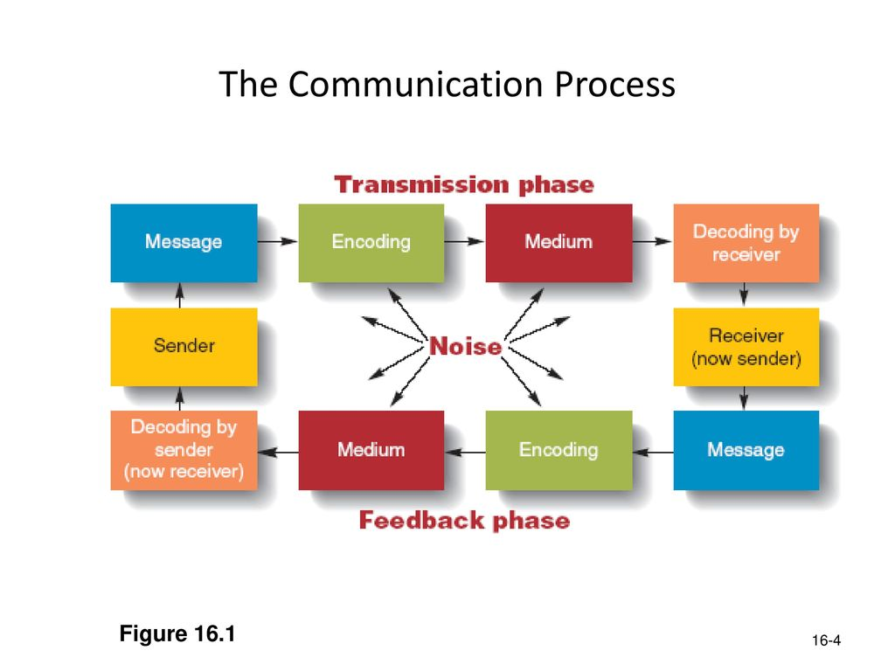

Slide 4
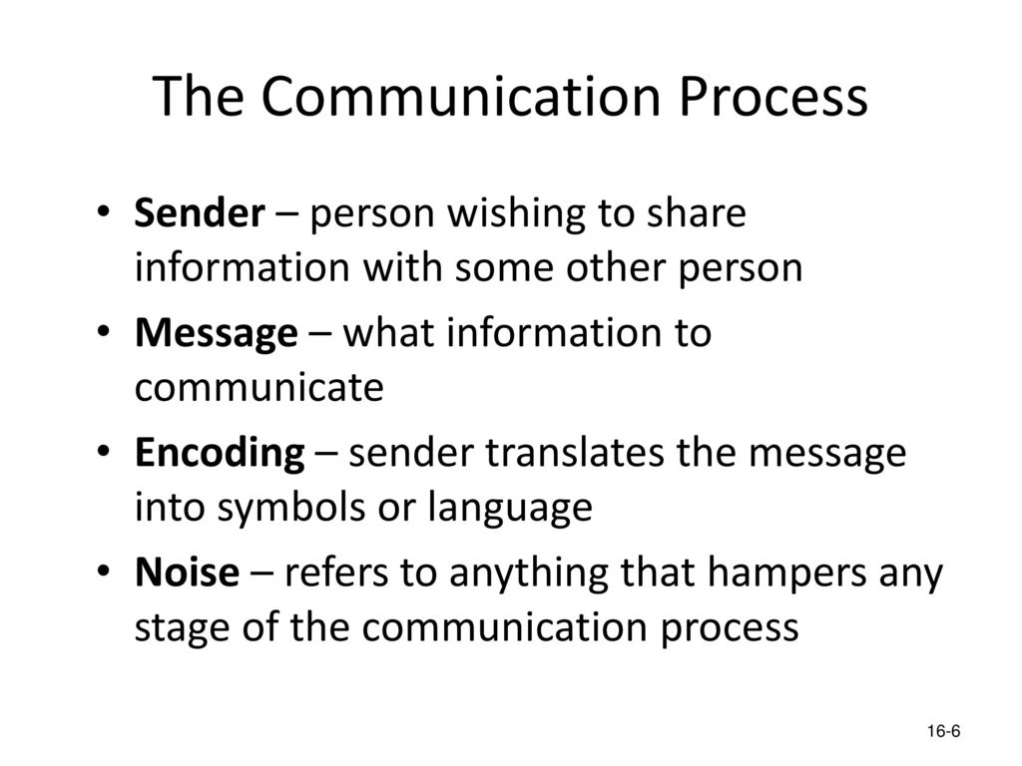

Slide 5
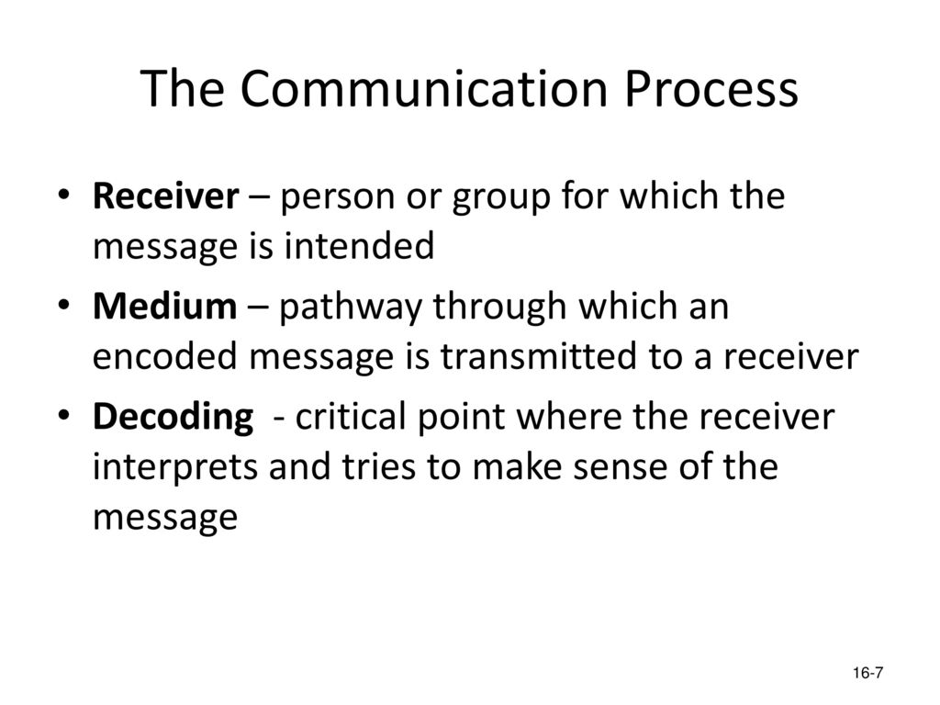
Feedback
Once the receiver confirms to the sender that he has received the message and understood it, the process of communication is complete.

Slide 6
The Basis of Co-ordination
The Basis of Decision Making
Fluent Working
Important of communication
Increases Cooperation and Organizational Peace
Increases Managerial Efficiency
Boosts Morale of the Employees

Slide 7
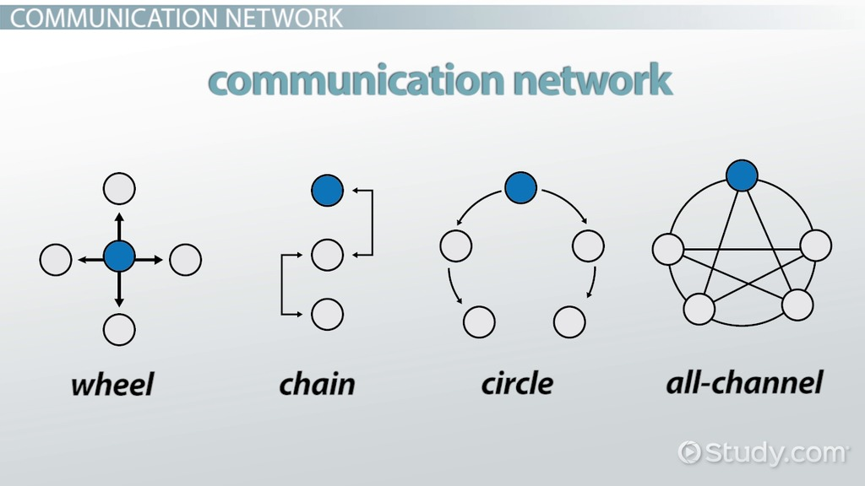
Network/ Structure of Communication

Slide 8
Network/ Structure of Communication
1 Wheel Network
Under the wheel communication network, the leader of the organization works as a central person to accumulate information and disseminate it to all the members. In-wheel network, the top-level manager is the source of information. He provides information within and outside the organization. Within the organization, he/she provides information to subordinates and also accumulates required information from them.
2 Chain Network
The chain network has all the appearance of an organizational chain of command. It is the vertical upward and downward form of the formal chain of communication. In this communication network, a person can communicate only with his immediate superior and subordinate.
3.Circle Network
It is a horizontal or sideward form of a circle network. In this network, a person can communicate to another person next to his right or left but not with any other member of the group. Such a network offers a wider option of channels and provides satisfaction to members.
4 All Channel Network
In all channel networks, all members can communicate with all the members without any formal restrictions. Members have more freedom to flow information among the group members. The leader of the group does not hold exceptional power to control group members. Therefore, it is known as an open communication network

Slide 9
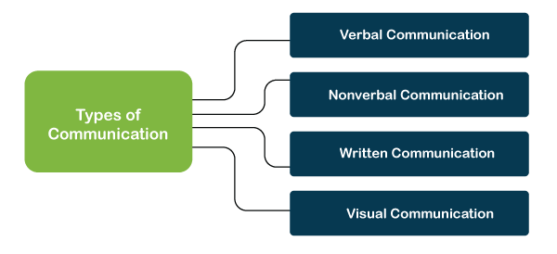
Types of communication

Slide 10
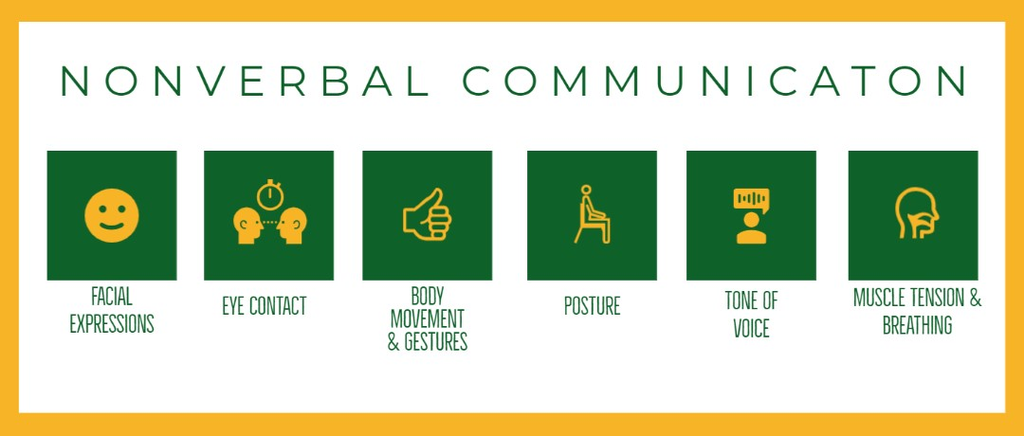

Slide 11
Verbal Communication
Verbal communication is the use of voice or language to convey information to the target audience. This can also include the transfer of information using sign language. Verbal communication is the most common and widely used type of communication. This can be seen in one-on-one conversations, group meetings, conferences, presentations, phone calls, etc. Verbal communication is so efficient that it can also support non-verbal and written communication in one way or another.
Verbal communication can be used in both formal and informal communications. For example, scheduling a meeting for office work over a phone call (formal) or talking to a friend over coffee (informal)
Terminating employees
Training others to perform a role or completing tasks
Speaking calmly, while worrying
Boldness
Using self-revelation to support sharing

Slide 12
Nonverbal Communication
Nonverbal communication uses our body language activity and gestures and facial expressions to convey information to the target audience. It can be used both ways, intentionally and unintentionally. For example, we can smile for a while when we hear positive or pleasant thoughts or information. It depends on the situation. This type of communication is beneficial when understanding the thoughts and feelings of others.
Body language
Eye contact
Facial expressions
Written Communication
Written communication is known as writing, typing, or printing symbols like letters and numbers to convey information to the target audience. This can include an email, a note, a report, a social media post, a tweet, etc. This type of communication is beneficial as it is in written form and can be used for reference or even record for evidence. This communication mode is mainly used to share information or knowledge through books, websites, blogs, pamphlets, etc
Letters
Postcards
Emails
Faxes
Social Media platforms or forums
Advertisements
Brochures
Proposals
Telegrams

Slide 13
Visual Communication
Visual communication refers to the use of visual actions and activities for conveying information to the target audience. This can involve arts, photographs, videos, graphs, charts, drawings, banners, sketches, etc. This type of communication is mostly seen to present advertisements. Apart from this, visuals are often used during the presentations to additional helpful context to the project. Visuals help display powerful contents alongside written, verbal and nonverbal communication. For example, Facebook is a platform that allows visual communications alongside videos, images, texts, etc.
Training videos or other educational presentation
Conferences
Social Media Graphics and posts
Websites
Trade shows
Office presentations

Slide 14
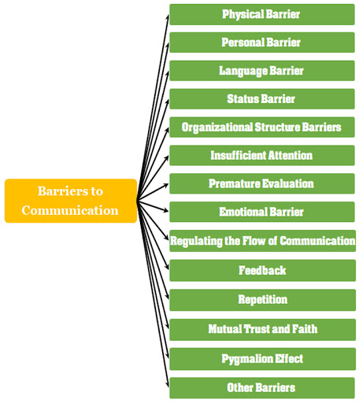
Barrier of effective communication

